Slide 1
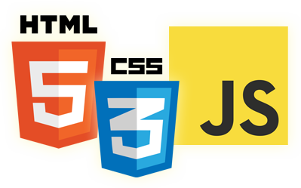


Symbols in ECMAScript 6.0
Eyal Vardi
Microsoft MVP ASP.NET blog: eyalvardi.wordpress.com

Slide 2
What is Symbols
A symbol is a unique and immutable data type and may be used as an identifier for object properties.
var firstName = Symbol();
var person = {};
person[firstName] = "Eyal";
console.log( person[firstName] ); // "Eyal"

Slide 3
Creating Symbols
The Symbol function accepts an optional argument that is the description of the symbol.
var firstName = Symbol("first name");
var person = {};
person[firstName] = "Eyal";
console.log("first name" in person); // false
console.log(person[firstName]); // "Eyal"
console.log(firstName); // "Symbol(first name)"
A symbol’s description is stored internally in a property called [[Description]] .
This property is read whenever the symbol’s toString() method is called.

Slide 4
Identifying Symbols
Since symbols are primitive values, you can use the typeof operator to identify them.
var symbol = Symbol("test symbol");
console.log( typeof symbol ); // "symbol"

Slide 5
Using Symbols
// Option 1:
var firstName = Symbol("first name");
var person = {};
person[firstName] = "Eyal";
// Option 2:
var person = {
[firstName] : "Eyal"
};
// Option 3:
// make the property read only
Object.defineProperty( person, firstName, { writable: false } );

Slide 6
Symbol.for() Method
First searches the global symbol registry to see if a symbol with the key exists.
If so, then it returns the already existing symbol.
If no such symbol exists, then a new symbol is created and registered into the global symbol registry using the specified key.

Slide 7
Well-Known Symbols

Slide 8
Public Symbols
They are all used as property keys and enable you to customize how JavaScript handles an object.
Basic operations
@@hasInstance
@@toPrimitive
@@.toStringTag
Symbol.iterator
Regular expressions
@@match
@@replace
@@split
Miscellaneous
@@unscopables
@@replace
@@split

Slide 9
@@toStringTag
class Person{
constructor(name){
this.name = name;
}
[Symbol.toStringTag](){
return "Person";
}
toString(){
return this.name; }
}
var me = new Person("Eyal Vardi");
console.log(me.toString()); // Eyal Vardi
console.log(Object.prototype.toString.call(me)); // Person

Slide 10
Resources
2ality blog (http://www.2ality.com/)
Understanding ECMAScript 6
http://ecmascript6.org/
A Few New Things Coming To JavaScript
Harmony of Dreams Come True
Harmony specification_drafts

Slide 11
Thanks
eyalvardi.wordpress.com
Eyal Vardi
Microsoft MVP ASP.NET blog: eyalvardi.wordpress.com

